Slide 1
Module 3
Managing Active Directory Domain Services Objects
Notes:
Presentation: 75 minutes
Lab: 70 minutes
After completing this module, students should be able to:
Manage user accounts with graphical tools.
Manage groups with graphical tools.
Manage computer accounts.
Delegate permission to perform Active Directory® Domain Services (AD DS) administration.
Required Materials
To teach this module, you need the Microsoft® Office PowerPoint® file 20410D_03.pptx.
Important: We recommend that you use Office PowerPoint 2007 or a newer version to display the slides for this course. If you use PowerPoint Viewer or an older version of PowerPoint, all the features of the slides might not be displayed correctly.
Preparation Tasks
To prepare for this module:
Read all of the materials for this module.
Practice performing the demonstrations and lab exercises.
Work through the Module Review and Takeaways section, and determine how you will use this section to reinforce student learning and promote knowledge transfer to on‑the‑job performance.
20410D
3: Managing Active Directory Domain Services Objects

Slide 2
Module Overview
Managing User Accounts Managing Groups Managing Computer Accounts Delegating Administration
Notes:
20410D
3: Managing Active Directory Domain Services Objects

Slide 3
Lesson 1: Managing User Accounts
AD DS Administration Tools Creating User Accounts Configuring User Account Attributes Creating User Profiles Demonstration: Managing User Accounts Demonstration: Using Templates to Manage User Accounts
Notes:
20410D
3: Managing Active Directory Domain Services Objects

Slide 4



Outils d’administration AD DS
Pour gérer les objets AD DS, on peut utiliser les outils graphiques suivants :
Active Directory Administration snap-ins
Active Directory Administrative Center
Ou alors les outils en lignes de commande suivants :
Active Directory module in Windows PowerShell
Directory Service commands
C:/
Notes:
Directory Service commands :
• dsadd : créer des nouveaux objets
• dsget : afficher la valeur des attributs d’un objet (exemple : numéro de téléphone d’un utilisateur)
• dsmod : éditer la valeur des attributs d’un objet
• dsmove : déplacer un objet
• dsquery : sélectionner un objet en fonction d’un critère de recherche
• dsrm : effacer un objet
Exemple : dsquery user –name Administrator | dsget user –tel
20410D
3: Managing Active Directory Domain Services Objects

Slide 5
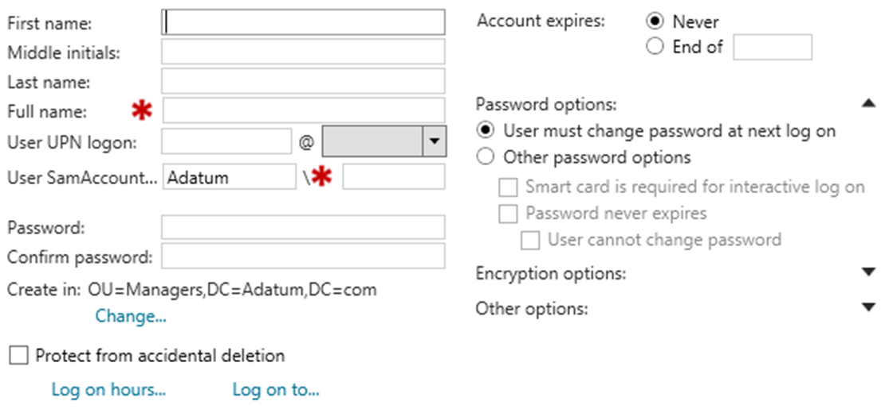
Création d’un compte utilisateur
En utilisant : Active Directory Administrative Center
Notes:
User sAMAccountName : unique dans le domaine
Full Name : unique dans l’UO
User UPN logon : unique dans la forêt
20410D
3: Managing Active Directory Domain Services Objects

Slide 6
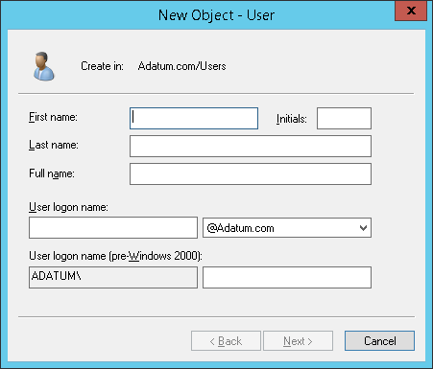
Création d’un compte utilisateur
En utilisant : Active Directory Users and Computers
Notes:
20410D
3: Managing Active Directory Domain Services Objects

Slide 7
Création d’un compte utilisateur
En utilisant : Windows PowerShell
New-ADUser -Name "Dan Park" -SamAccountName "Dan" -Path "OU=Sales,DC=Adatum,DC=com"
-AccountPassword (ConvertTo-SecureString -AsPlaintext "Pa$$w0rd" -Force)
-GivenName "Dan" -Surname "Park" -DisplayName "Dan Park" -Enabled $True
-UserPrincipalName "Dan@Adatum.com" -ChangePasswordAtLogon $false
Notes:
20410D
3: Managing Active Directory Domain Services Objects

Slide 8
Création d’un compte utilisateur
En utilisant : Directory Service commands (dsadd)
dsadd user "cn=Joe Healy,ou=Managers,dc=adatum,dc=com" -pwd Pa$$w0rd -disabled no -acctexpires never -mustchpwd no
Notes:
20410D
3: Managing Active Directory Domain Services Objects

Slide 9
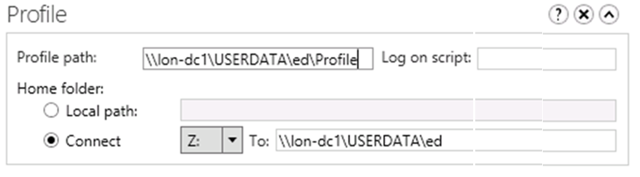
Création d’un profil utilisateur
Allez dans l‘onglet « profil » qui se trouve dans les propriétés d’un profil.
Notes:
20410D
3: Managing Active Directory Domain Services Objects

Slide 10
Gestion de Comptes Utilisateur (PowerShell)
Changement de mot de passe :
Set-ADAccountPassword ‑identity ‘cn=amy, ou=IT, dc=contoso, dc=com’ ‑Reset ‑NewPassword (ConvertTo SecureString ‑AsPlainText “Pa$$w0rd2” ‑Force)
Déverrouiller un compte utilisateur
Unlock-ADAccount ‑identity ‘cn=amy strand, ou=IT, dc=contoso, dc=com’
Activer/Désactiver un compte utilisateur
Enable-ADAccount ‑identity <name>
Disable-ADAccount ‑identity <name>
Notes:
Différence entre un compte verrouillé et un compte désactivé ?
20410D
3: Managing Active Directory Domain Services Objects
(More notes on the next slide)

Slide 11
Gestion de Comptes Utilisateur
Voir zone “commentaires”.
Notes:
Demonstration Steps
Delete a user account
Sign in to LON‑DC1 as Adatum\Administrator with the password Pa$$w0rd.
On LON‑DC1, in Server Manager, click Tools.
Click Active Directory Administrative Center.
In the Active Directory Administrative Center, click Adatum (local), and then double‑click Managers.
In Managers, right‑click Ed Meadows, and then click Delete.
In the Delete Confirmation dialog box, click Yes.
Create a new user account
In the Action pane, click New, and then click User.
In the Create User dialog box, in Full name, type Ed Meadows.
In User UPN logon, type Ed.
In Password and Confirm password, type Pa$$w0rd, and then click OK.
Move the user account
Right‑click Ed Meadows, and then click Move.
Click the IT organizational unit (OU), and then click OK.
In the navigation pane, click Adatum (local).
In the results pane, double‑click IT.
Verify that Ed Meadow’s account is listed.
(More notes on the next slide)
20410D
3: Managing Active Directory Domain Services Objects

Slide 12
Gestion de Comptes Utilisateur
Voir zone “commentaires”.
Notes:
View the WINDOWS POWERSHELL HISTORY
If you have not already done so, maximize Active Directory Administrative Center.
At the bottom of the Active Directory Administrative Center window, click WINDOWS POWERSHELL HISTORY to expand the history section.
Discuss the following commands and switches:
The Remove-ADObject command and the switches used with it to delete Ed Meadows.
The New-ADUser command and the switches used with it to recreate Ed Meadows.
The additional commands used to configure the Ed Meadows account.
The Move-ADObject command and the switches used with it to move Ed Meadows.
Close the Active Directory Administrative Center.
Find users who have not signed in during the last 30 days
On the taskbar, click the Windows PowerShell icon.
To create a variable to specify the past 30 days, type the following command, and then press Enter:
$logonDate = (get‑date).AddDays(‑30)
To find all the user accounts that have not signed in during the past 30 days, type the following command, and then press Enter:
Get‑ADUser ‑Filter{lastLogon ‑le $logonDate}
The results include nearly every account in the domain because most of the accounts have never signed in.
(More notes on the next slide)
20410D
3: Managing Active Directory Domain Services Objects

Slide 13
Gestion de Comptes Utilisateur
Voir zone “commentaires”.
Notes:
Find and delete all disabled user accounts
To find all the disabled user accounts, type the following command, and then press Enter:
Get-ADUser ‑Filter{enabled ‑ne $True}
The results should list four accounts in the Sales OU and two system accounts in the Users container, Guest and krbtgt.
To delete the disabled user accounts in the Sales OU without being prompted for confirmation, type the following command, and then press Enter:
Get-ADUser ‑SearchBase "OU=Sales,DC=Adatum,DC=com" ‑Filter{enabled ‑ne $true} | Remove‑adobject ‑Confirm:$False
If this command runs successfully, there is no output.
To verify that the disabled accounts have been deleted, type the following command, and then press Enter:
Get-ADUser ‑Filter{enabled ‑ne $True}
The results should list the two system accounts in the Users container, Guest and krbtgt.
Leave the virtual machine running for the next demonstration.
20410D
3: Managing Active Directory Domain Services Objects

Slide 14
Démonstration: Les “templates”
On LON‑DC1, in Server Manager, click Tools, and then click Active Directory Administrative Center.
In the Active Directory Administrative Center, click Adatum (local), and then double‑click Sales.
In the Action pane, click New, and then click User.
In the Create User dialog box, in First name, type _LondonSales, in Last name, type Template.
In User UPN logon, type _LondonSales.
Select Protect from accidental deletion.
Under Organization, in Department, type Sales.
In Company, type A. Datum.
Notes:
20410D
3: Managing Active Directory Domain Services Objects
(More notes on the next slide)

Slide 15
Démonstration: Les “templates”
In City, type London.
In Description, type London Sales users.
In the Member of section, click Add.
In Enter the object names to select, type Sales, and then click OK.
In the Create User _LondonSales Template dialog box, click OK.
Notes:
20410D
3: Managing Active Directory Domain Services Objects
(More notes on the next slide)

Slide 16
Démonstration: Les “templates”
Create a user from the _LondonSales template
In the Windows PowerShell window, create a variable ($LondonSales) to hold the _LondonSales properties by using the following command, and then press Enter:
$LondonSales = Get‑ADUser ‑Identity "_LondonSales" ‑Properties Department,Company,City
To create a new Sales user in the Sales OU, type the following command, and then press Enter:
New‑ADUser ‑Name "Dan Park" ‑SamAccountName "Dan" ‑Path "OU=Sales,DC=Adatum,DC=com" ‑AccountPassword (ConvertTo‑SecureString ‑AsPlaintext "Pa$$w0rd" ‑Force) ‑GivenName "Dan" ‑Surname "Park" ‑DisplayName "Dan Park" ‑Enabled $True ‑UserPrincipalName "Dan@Adatum.com" ‑ChangePasswordAtLogon $true ‑Instance $LondonSales
Verify the User Properties
In the Windows PowerShell window, type the following command, and then press Enter:
Get-ADUser –Identity “Dan” –Properties *
Verify that the properties that you defined in the template were copied to the new user.
Notes:
20410D
3: Managing Active Directory Domain Services Objects
(More notes on the next slide)

Slide 17
Lesson 2: Managing Groups
Group Types Group Scopes Implementing Group Management Default Groups Special Identities Demonstration: Managing Groups
Notes:
Some students who are inexperienced with Windows Server often have difficulty grasping the concept of groups within groups. Consider using your whiteboard to go through the following example:
Draw three domains as triangles, and add a file resource to each domain.
Ask your students how many file permissions are required if each domain hosts 100 users who each need access to the three file resources in your three domains.
Group the three sets of 100 users, and repeat the question.
Group the groups, and repeat the question.
This elegantly demonstrates the benefit of nesting groups.
Now all you need to do is to explain the particulars of the types and scopes in Windows Server. As with Lesson 1, consider making the demonstration the focus of this lesson.
20410D
3: Managing Active Directory Domain Services Objects

Slide 18




Les Types de Groupes
Groupe de distribution
Utilisé avec les applications mail.
Non « sécure » (pas de SID). Attribuer des autorisations impossible.
Groupe de sécurité
« sécure » (avec SID). Attribuer des autorisations possible.
Peut également être utilisé avec les applications mail.
Un groupe de distribution peut être converti en groupe de sécurité et vice-versa.
Notes:
Explain to students that they can use distribution groups to send email messages to collections of users, but only with messaging programs such as Microsoft Exchange Server. Stress that distribution lists are not security-enabled, so they cannot be listed in discretionary access control lists (DACLs).
Also explain to students that they can use security groups to assign rights and permissions to both groups of users and groups of computers. A security group is security-enabled, and you can use it to assign permissions to local and network resources.
20410D
3: Managing Active Directory Domain Services Objects

Slide 19
Etendue des groups
Group scope | Members from same domain | Members from domain in same forest | Members from trusted external domain | Can be assigned permissions to resources
Local | U, C, GG, DLG, UG and local users | U, C, GG, UG | U, C, GG | On the local computer only
Domain-local | U, C, GG, DLG, UG | U, C, GG, UG | U, C, GG | Anywhere in the domain
Universal | U, C, GG, UG | U, C, GG, UG | N/A | Anywhere in the forest
Global | U, C, GG | N/A | N/A | Anywhere in the domain or a trusted domain
U User C Computer GG Global group DLG Domain-local group UG Universal group
Notes:
Use the table to describe group scopes. Consider drawing a diagram with several domains that shows where you can create groups, and the implications of each group scope.
20410D
3: Managing Active Directory Domain Services Objects

Slide 20
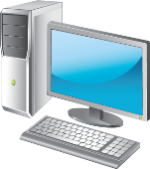

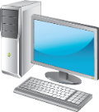

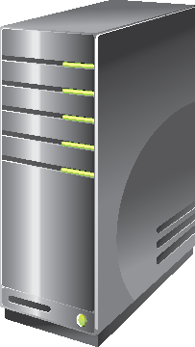

Stratégie IGDLA
I
Identities
Users or computers,
which are members of
Global groups
Which collect members based on members’ roles,
which are members of
Sales
(Global group)
G
Auditors
(Global group)
ACL_Sales_Read (Domain-local group)
DL
Domain-local groups
Which provide management
such as resource access,
which are
A
Assigned access to a resource
This best practice for nesting groups is known as IGDLA.
Notes:
This slide and the next five explain the example in the student notes. This slide summarizes the example, and the next five slides build up the example frame by frame. The five frames are:
Identities
Global groups
Domain-local groups
Assigned resource access
A copy of the summary, as shown in the first slide above
Alternatively, draw an illustration on the whiteboard by using the following guidelines to illustrate the advantage of group nesting:
Draw three domain objects, each containing five users. Draw a file object in one of the three domains.
Question: How many file permissions do you need to create to assign permissions on this file for each user?
Answer: You need to create 15 file permissions.
Draw a circle around the five users in each domain, and explain that the circles represent global groups.
Question: How many permissions on the file do you need to assign at the global group level?
Answer: You need to assign three permissions.
Draw a circle adjacent to the file. Draw arrows from your global groups to this circle, indicating that you have added these groups to a local group in the resource holding domain.
Question: How many permissions must you assign to the local group?
Answer: You must assign one permission to the local group.
20410D
3: Managing Active Directory Domain Services Objects

Slide 21
Groupes par défaut
Group | Location
Enterprise Admins | Users container of the forest root domain
Schema Admins | Users container of the forest root domain
Administrators | Built-in container of each domain
Domain Admins | Users container of each domain
Server Operators | Built-in container of each domain
Account Operators | Built-in container of each domain
Backup Operators | Built-in container of each domain
Print Operators | Built-in container of each domain
Cert Publishers | Users container of each domain
Notes:
Entreprise Admins : Membre du groupe Administrateurs. Les utilisateurs de ce groupe peuvent gérer la partition « Configuration » et ont également un contrôle total de la partition « Domaine ».
Schema Admins : Contrôle total du schéma.
Administrators : Contrôle total des contrôleurs de domaine, ainsi que des données de la partition domaine.
Domain Admins : Ajouté au groupe Administrateurs et au groupe Administrateurs locaux. Les membres de ce groupent ont la capacité de gérer n’importe quelle machine du domaine.
Server Operators : Gèrent la maintenant des contrôleurs de domaine (start/stop services, sauvegarde/restauration, etc). Par défaut, aucun membre dans ce groupe.
Account Operators : Gèrent les comptes (users, groupes, etc). Par défaut, aucun membre dans ce groupe.
Backup Operators : Gèrent la sauvegarde/restauration d’un DC. Par défaut, aucun membre dans ce groupe.
Print Operators : Gèrent la file d’attente du service d’impression.
Cert Publishers : Gèrent la publication de certificats.
Tout ceci forme ce qu’on appelle les groupes protégés.
20410D
3: Managing Active Directory Domain Services Objects

Slide 22
Identités spéciales
Groupes dont l’adhésion est gérée par le système d’exploitation.
Utilisé par le système d'exploitation Windows Server pour donner accès aux ressources :
Basé sur le type d’authentification ou connexion.
Et non sur un compte utilisateur.
Exemple d’identités spéciales :
Anonymous Logon Authenticated Users Everyone | Interactive (connexion locale) Network Creator Owner (sécurité à la création d’un objet)
Notes:
20410D
3: Managing Active Directory Domain Services Objects

Slide 23
Demonstration: Managing Groups
In this demonstration, you will see how to:
Create a new group
Add members to the group
Add a user to the group
Change the group type and scope
Modifying the group’s Managed By property
Notes:
Preparation Steps
The required virtual machine, 20410D‑LON‑DC1, should be running after the previous demonstration.
Demonstration Steps
Create a new group
On LON‑DC1, switch to Active Directory Administrative Center.
Expand Adatum (Local), and then click IT.
In the Tasks list, under IT, point to New, and then click Group.
In the Create Group dialog box, in Group name, type IT Managers.
Add members to the group
Scroll down, and under Members, click Add.
In the Select Users, Contacts, Computers, Service Accounts, or Groups dialog box, in Enter the object names to select (examples), type April; Don.
Click Check Names, and then click OK.
In the Create Group IT Managers dialog box, click OK.
Add a user to the group
In the details pane, right‑click Ed Meadows.
Click Add to group.
In the Select Groups dialog box, in Enter the object names to select (examples), type IT Managers.
Click Check Names, and then click OK.
20410D
3: Managing Active Directory Domain Services Objects
(More notes on the next slide)

Slide 24
Notes:
Change the group type and scope
In the details pane, double‑click IT Managers.
In the IT Managers dialog box, under Group scope, click Universal.
Under Group type, click Distribution, and then click OK.
Modify the group’s Managed By property
In the details pane, double‑click IT Managers.
In the details pane, under Managed By, click Edit.
In the Select User, Contact or Groups dialog box, in Enter the object names to select (examples), type Ed Meadows, click Check Names, and then click OK.
Select Manager can update membership list, and then click OK.
Leave the virtual machine running for the next demonstration.
20410D
3: Managing Active Directory Domain Services Objects

Slide 25
Lesson 3: Managing Computer Accounts
What Is the Computers Container? Specifying the Location of Computer Accounts Controlling Permissions to Create Computer Accounts Performing an Offline Domain Join Computer Accounts and Secure Channels Resetting the Secure Channel Bring Your Own Device
Notes:
There are no demonstrations in this lesson. As you proceed through the content, consider performing small, impromptu demonstrations to help reinforce the content.
20410D
3: Managing Active Directory Domain Services Objects

Slide 26
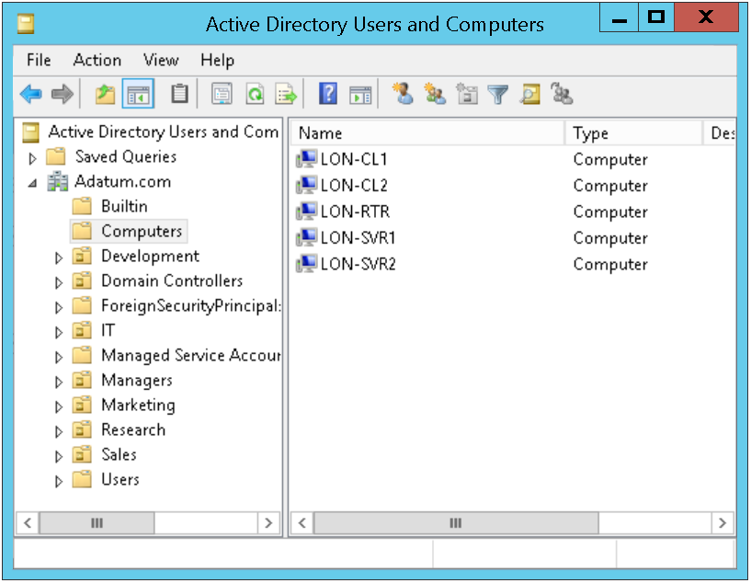
Computers Container
Notes:
Distinguished Name “cn=Computers,DC=Adatum,DC=com”
Pour changer le computers container : redircmp ou=mycomputers, DC=contoso, dc=com
20410D
3: Managing Active Directory Domain Services Objects

Slide 27
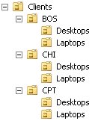
Specifying the Location of Computer Accounts
Bonne pratique :
Servers
Diviser par rôle
Client computers
Diviser par région
Division des OU:
Selon les droits d’administration
Pour faciliter l’utilisation des GPO
Notes:
20410D
3: Managing Active Directory Domain Services Objects

Slide 28
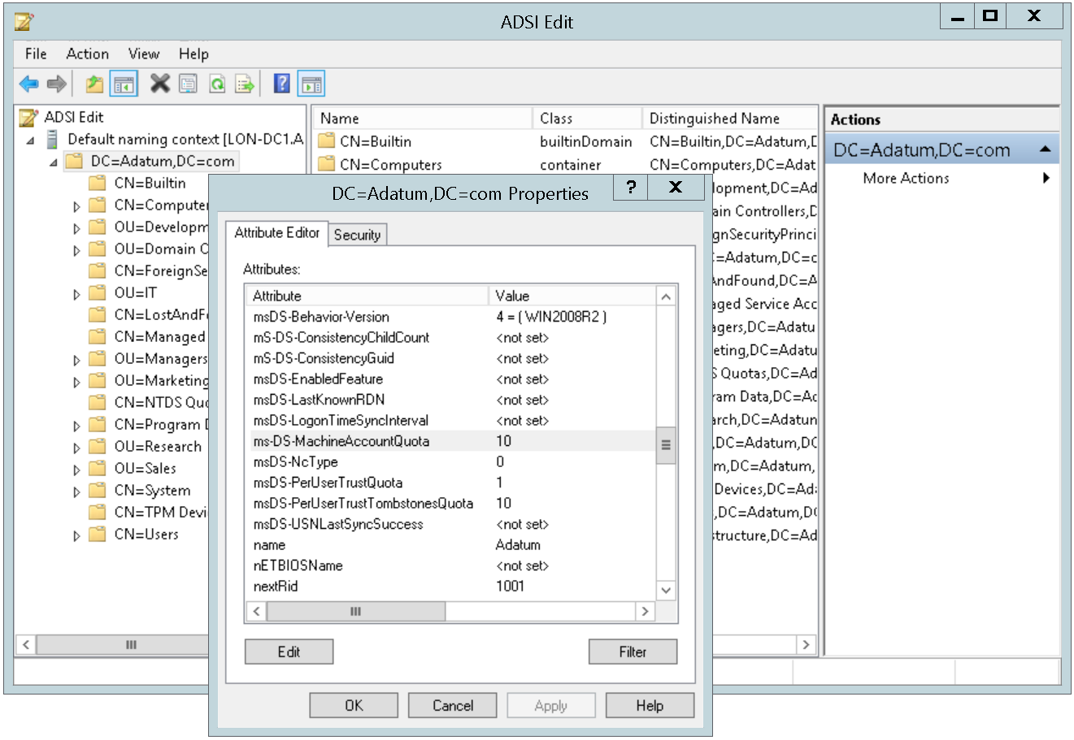
Lever la limite de comptes ordinateurs (10 par défaut)
Notes:
20410D
3: Managing Active Directory Domain Services Objects

Slide 29
Performing an Offline Domain Join
Create a domain join file using:
Import the domain join file using:
djoin.exe /Provision /Domain <DomainName> /Machine <MachineName> /SaveFile <filepath>
djoin.exe /requestODJ /LoadFile <filepath> /WindowsPath <path to the Windows directory of the offline image> /localos
Notes:
Exemple :
- djoin.exe /Provision /Domain adatum.com /Machine LON-CL1 /SaveFile C:\offlinedomainjoin.txt
- djoin.exe /requestODJ /loadfile C:\offlinedomainjoin.txt /windowspath %SystemRoot% /localos
20410D
3: Managing Active Directory Domain Services Objects

Slide 30
Compte ordinateur et canal sécurisé
Compte ordinateur
Couple login (sAMAccountName) et mot de passe
Utilisé afin de créer un canal sécurisé entre l’ordinateur et le contrôleur de domaine
Scenarios où ce canal sécurisé peut être brisé
Réinstallation d’un ordinateur (génération d’un nouveau SID)
Restauration d’un ordinateur à partir d’un point de sauvegarde ou d’un snapshot
Désaccord entre l’ordinateur et le domaine à propos du mot de passe
Non utilisation de l’ordinateur durant une longue période : reset ou effacement du compte
Notes:
20410D
3: Managing Active Directory Domain Services Objects

Slide 31
Reset d’un canal sécurisé
Ne pas effacer le compte ordinateur et l’ajouter à nouveau au domaine !!!
Création d’un nouveau compte > Nouveau SID > Perte de toutes les associations de groupes
Options pour resetter un canal sécurisé
Active Directory Users and Computers
Active Directory Administrative Center
dsmod
netdom
nltest
Windows PowerShell
Notes:
dsmod : dsmod computer “ComputerDN” –reset
netdom : netdom reset MachineName /domain DomainName /UserO UserName /PasswordO {Password | *}
nltest : nltest /server:servername /sc_reset:domain\domaincontroller
PowerShell : Test-ComputerSecureChannel -Repair
20410D
3: Managing Active Directory Domain Services Objects

Slide 32
Lesson 4: Delegating Administration
Considerations for Using Organizational Units AD DS Permissions Effective AD DS Permissions Demonstration: Delegating Administrative Permissions
Notes:
Consider starting the demonstration topic, and then discussing the content in the other three topics. Start the lesson by asking your students to consider at what point a single administrator is unable to manage a network alone, and how best to allocate administrative tasks to other administrators.
20410D
3: Managing Active Directory Domain Services Objects

Slide 33
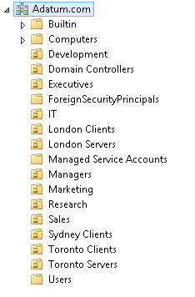
Utilisation des Unités d’organisation
Les OUs permettent de subdiviser le domaine afin de mieux le gérer
Les OUs sont utilisées pour :
Faire de la délégation
Appliquer des GPOs
Les OUs peuvent avoir une structure :
Plate (un à deux niveaux de profondeur)
Profonde (plus de 5 niveaux de profondeur)
Ou n’importe quoi entre les deux
Les OUs se définissent en fonction de la situation géographique, des départements existants ou bien du type de ressources…
Notes:
20410D
3: Managing Active Directory Domain Services Objects

Slide 34
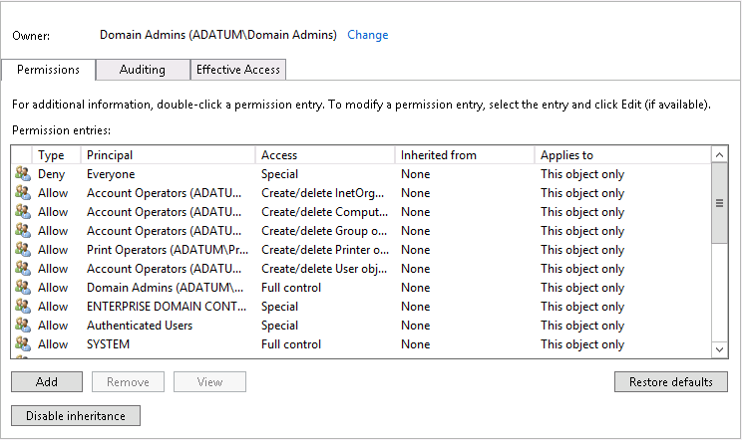
AD DS Permissions
Advanced Security Settings for IT
Notes:
20410D
3: Managing Active Directory Domain Services Objects

Slide 35
Effective AD DS Permissions
Vue d’ensemble des permissions attribuées aux utilisateurs ou aux groupes
Une bonne pratique est d’attribuer une permission à un groupe et non directement aux utilisateurs
En cas de conflit :
Un « Deny » écrase un « Allow »
Une permission explicite écrase une permission héritée
Un « Allow » explicite écrase un « Deny » hérité
Pour visualiser les permissions effectives :
L’onglet « Effective Access »
Commande dsacls
Notes:
!!!!! Une permission non autorisée sur une tâche, la rend impossible à l’exécuter. Pourquoi alors utiliser un « deny » ? (deux raisons) !!!!!!
20410D
3: Managing Active Directory Domain Services Objects

Slide 36
Demonstration: Delegating Administrative Permissions
In this demonstration, you will see how to:
Create an OU
Move objects into an OU
Delegate a standard task
Delegate a custom task
View AD DS permissions resulting from these delegations
Notes:
Discussion Prompt
You can manage delegation of control in Active Directory Domain Services (AD DS) either manually or by using the Delegation of Control Wizard. If you have a complex permission scenario, you may need to configure the permissions manually, but it is usually easier to assign permissions in AD DS by using the Delegation of Control Wizard.
Preparation Steps
The required virtual machine, 20410D‑LON‑DC1, should be running after the previous demonstration.
Demonstration Steps
Create an OU
On LON‑DC1, in Server Manager, click Tools, and then click Active Directory Users and Computers.
Expand the Adatum.com domain.
Right click Adatum.com, point to New, and then click Organizational Unit.
In the New Object – Organizational Unit dialog box, in Name, type Executives.
Note: Discuss the purpose of the Protect Container From Accidental Deletion setting.
In the New Object – Organizational Unit dialog box, click OK.
Move users into the Executives OU
Click the Managers OU.
Click Carol Troup, and then hold down Shift while clicking Euan Garden.
Right click Euan Garden, and then click Move.
In the Move dialog box, click Executives, and then click OK.
20410D
3: Managing Active Directory Domain Services Objects
(More notes on the next slide)

Slide 37
Notes:
Delegate a standard task
In the navigation pane, right‑click Executives, and then click Delegate Control.
In the Delegation of Control Wizard, click Next.
On the Users or Groups page, click Add.
In the Select Users, Computers, or Groups dialog box, in Enter the object names to select (examples), type IT, and then click OK.
On the Users or Groups page, click Next.
On the Tasks to Delegate page, in the Delegate the following common tasks list, select the following options, and then click Next
Create, delete, and manage user accounts,
Reset user passwords and force password change at next logon,
Read all user information
On the Completing the Delegation of Control Wizard page, click Finish.
Delegate a custom task
In the navigation pane, right‑click Executives, and then click Delegate Control.
In the Delegation of Control Wizard, click Next.
On the Users or Groups page, click Add.
In the Select Users, Computers, or Groups dialog box, in Enter the object names to select (examples), type IT, and then click OK.
On the Users or Groups page, click Next.
On the Tasks to Delegate page, click Create a custom task to delegate, and then click Next.
On the Active Directory Object Type page, click Only the following objects in the folder.
In the list, select Computer objects.
Select Create selected objects in this folder and Delete selected objects in this folder, and then click Next.
(More notes on the next slide)
20410D
3: Managing Active Directory Domain Services Objects

Slide 38
Notes:
On the Permissions page, in the Permissions list, select Full Control, and then click Next.
On the Completing the Delegation of Control Wizard page, click Finish.
View AD DS permissions resulting from these delegations
On the View menu, click Advanced Features.
In the navigation pane, right‑click Executives, and then click Properties.
In the Executives Properties dialog box, on the Security tab, click Advanced.
In the Advanced Security Settings for Executives dialog box, notice the Allow permissions that are assigned to IT (ADATUM\IT). These were created during the delegation process.
Click Cancel twice, and then close all open windows except Server Manager.
After you complete the demonstration, revert all virtual machines.
20410D
3: Managing Active Directory Domain Services Objects

Slide 39
Lab: Managing Active Directory Domain Services Objects
Exercise 1: Delegating Administration for a Branch Office Exercise 2: Creating and Configuring User Accounts in AD DS Exercise 3: Managing Computer Objects in AD DS
Logon Information
Virtual machines 20410D‑LON‑DC1
20410D‑LON‑CL1
User name Adatum\Administrator
Password Pa$$w0rd
Estimated Time: 70 minutes
Notes:
Before students begin the lab, read the lab scenario and display the next slide. Before each exercise, read the scenario associated with the exercise to the class. The scenarios give context to the lab and exercises, and help to facilitate the discussion at the end of the lab. Remind students to complete the discussion questions after the last lab exercise.
Exercise 1: Delegating Administration for a Branch Office
A. Datum delegates management of each branch office to a specific group. This allows an employee who works onsite to be configured as an administrator when required. Each branch office has a branch administrators group that can perform full administration within the branch office OU. There is also a branch office help desk group that is able to manage users in the branch office OU, but not other objects. You need to create these groups for the new branch office and delegate permissions to the groups.
Exercise 2: Creating and Configuring User Accounts in AD DS
You have a list of new users for the branch office, and you need to create user accounts for them.
Exercise 3: Managing Computer Objects in AD DS
A workstation has lost its connectivity to the domain and cannot authenticate users properly. When users attempt to access resources from this workstation, access is denied. You need to reset the computer account to recreate the trust relationship between the client and the domain.
20410D
3: Managing Active Directory Domain Services Objects

Slide 40
Lab Scenario
You have been working for A. Datum Corporation as a desktop support specialist and have visited desktop computers to troubleshoot app and network problems. You have recently accepted a promotion to the server support team. One of your first assignments is to configure the infrastructure service for a new branch office.
To begin deployment of the new branch office, you are preparing AD DS objects. As part of this preparation, you need to create an OU for the branch office and delegate permission to manage it. Then you need to create users and groups for the new branch office. Finally, you need to reset the secure channel for a computer account that has lost connectivity to the domain in the branch office.
Notes:
20410D
3: Managing Active Directory Domain Services Objects

Slide 41
Lab Review
What are the options for modifying the attributes of new and existing users? What types of objects can be members of global groups? What types of objects can be members of domain-local groups? Which two credentials are necessary for any computer to join a domain?
Notes:
Lab Review Questions
Question
What are the options for modifying the attributes of new and existing users?
Answer
You can modify attributes of new and existing users in the following ways:
Select multiple users and then open the Properties dialog box
Use the dsmod command
Create a user account based on a user account template
Use the Set-ADUser Windows PowerShell cmdlet
Question
What types of objects can be members of global groups?
Answer
Global groups can include as members users and other roles (global groups) from the same domain.
Question
What types of objects can be members of domain-local groups?
Answer
Domain-local groups can contain roles (global groups) and individual users from any trusted domain in the same forest or an external forest, and other domain-local groups in the same domain. Finally, domain-local groups can contain universal groups from anywhere in the forest.
Question
Which two credentials are necessary for any computer to join a domain?
Answer
The necessary credentials are the local credentials that are in the local Administrators group of the computer, and domain credentials that have permissions to join a computer to the computer account.
20410D
3: Managing Active Directory Domain Services Objects

Slide 42
Module Review and Takeaways
Review Questions Best Practices
Tools
Notes:
Module Review Questions
Point students to the appropriate section in the course so that they are able to answer the questions that this section presents.
Question
Your company has branches in multiple cities, and each branch has a local domain that is part of the company forest. Each branch also has their own printers that are managed by using domain-local groups from their local domain. The company's sales people frequently travel between locations.
How can you provide the sales people with access to the various printers as they travel between locations?
Answer
You can create a group with domain local scope, and assign it permission to access the printer. Put the Sales user accounts in a group with global scope, and then add this group to the group that has domain-local scope. When you want to give the Sales users access to a new printer, assign the group with domain-local scope permission to access the new printer. All members of the group with global scope receive access to the new printer automatically.
Question
You are responsible for managing accounts and access to resources for your group members. A user in your group transfers to another department within the company. What should you do with the user’s account?
Answer
Although your company might have a Human Resources representative with AD DS permissions to move user accounts, the best solution is to move the user account into the appropriate OU of the new department. In this manner, the Group Policies associated with the new department are enforced. If applying the correct Group Policies is important, the user’s account should be disabled until someone with appropriate security permissions can move it into the new OU.
Question
What is the main difference between the Computers container and an OU?
Answer
You cannot create an OU within a Computers container, so you cannot subdivide the Computers container. In addition, you cannot link a GPO to a container. Because of this, as a best practice you should move newly created computer accounts from the Computers container to an OU.
20410D
3: Managing Active Directory Domain Services Objects
(More notes on the next slide)

Slide 43
Notes:
Question
When should you reset a computer account? Why is it better to reset the computer account rather than to disjoin and then rejoin it to the domain?
Answer
You should reset a computer account when the computer is no longer able to authenticate to the domain. That can happen if the operating system is reinstalled, if the computer is restored from backup, or if the password is out of the synchronization interval.
It is better to reset the computer account because if you disjoin the computer from a domain and then rejoin it, you risk losing the computer account completely, which results in loss of the computer’s SID and, more importantly, its group memberships. When you rejoin the domain, even though the computer has the same name, the account has a new SID, and all the group memberships of the previous computer object must be recreated.
Question
A project manager in your department is starting a group project that will continue for the next year. Several users from your department and other departments will be dedicated to the project during this time. The project team must have access to the same shared resources. The project manager must be able to manage the user accounts and group accounts in AD DS; however, you do not want to give the project manager permission to manage anything else in AD DS. What is the best way to do this?
Answer
The best way to do this is to create a new global security group and then add the project members to the group. Create a new OU outside your department’s OU, and then assign full control of the OU to the project manager. Add the global group to the new OU, and then add resources, such as shared files and printers, to the OU. Keep track of the project, and delete the global group when the work finishes. You can keep the OU if another project requires it; however, you should delete it if there is no immediate need for it.
(More notes on the next slide)
20410D
3: Managing Active Directory Domain Services Objects

Slide 44
Notes:
Question
You are working as an IT technician in Contoso, Ltd. You are managing the Windows Server–based infrastructure. You have to find a method for joining new Windows 8.1‑based computers to a domain during the installation process, without intervention of a user or an administrator. What is the best way to do this?
Answer
The best way to do this is to provision the computer accounts to AD DS by using the djoin command‑line tool with the /provision switch, and then use an unattended setup to perform the installation. By using a tool such as Windows System Image Manager, you can perform an unattended domain join during an operating system installation by providing information in an Unattend.xml file that is relevant to the domain join.
(More notes on the next slide)
20410D
3: Managing Active Directory Domain Services Objects

Slide 45
Notes:
Best Practices
The following are recommended best practices:
Best Practices for User Account Management
Do not let users share user accounts. Always create a user account for each individual, even if that person will not be with your organization for a long time.
Educate users about the importance of password security.
Ensure that you choose a naming strategy for user accounts that enables you to identify the user to whom the account relates. Also ensure that your naming strategy uses unique names within your domain.
Best Practices for Group Management
When you manage access to resources, try to use both domain-local groups and role groups.
Use universal groups only when necessary because they add weight to replication traffic.
Use Windows PowerShell with Active Directory Module for batch jobs on groups.
Avoid adding users to built‑in and default groups.
Best Practices Related to Computer Account Management
Always provision a computer account before joining computers to a domain, and then place them in appropriate OU.
Redirect the default Computers container to another location.
Reset the computer account, instead of disjoining and rejoining.
Integrate the offline domain join functionality with unattended installations.
(More notes on the next slide)
20410D
3: Managing Active Directory Domain Services Objects

Slide 46
Notes:
20410D
3: Managing Active Directory Domain Services Objects
Tools

